Slide 2

Renewable Power Plants

Slide 3
Hydro Power Plants
Since the beginning of civilization
Mainly used to generate mechanical driving power
Water has potential energy stored (altitude)
By flowing downwards – converted to kinetic energy
Types
River power plant
Storage power plant (incl. pump storage)
Oceanic power plant

Slide 4
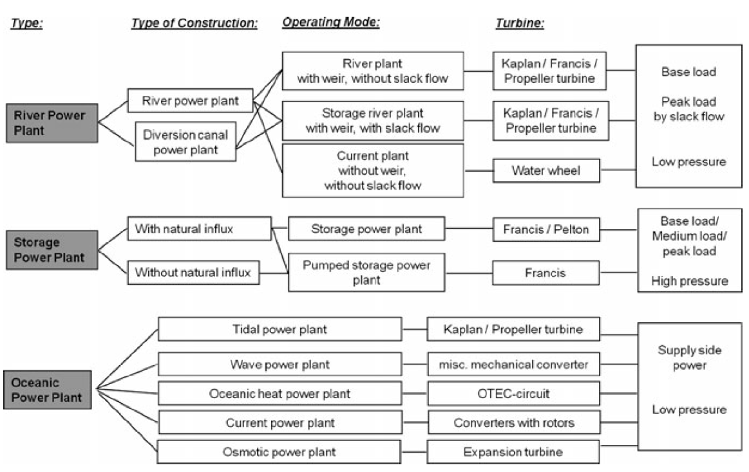
Overview of hydro power plants

Slide 5
River Power Plant (dt. Flusskraftwerke)
Also known as run-of-river power plants
Natural flow of water is used to generate electricity
Can be
Build directly into the river
Fed by diversion canal
Directly in the river
Can produce more power
Diversion canal
Water is separated and led to the power house
Activities on the river are not influenced

Slide 6
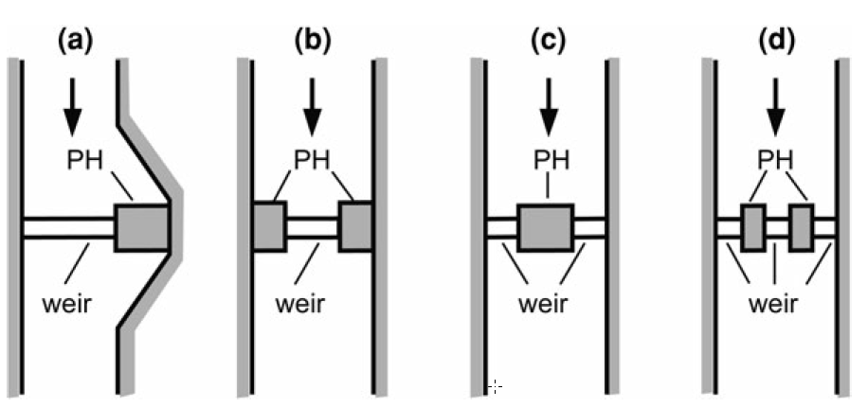
River Power Plant
Several possibilities to place the power house within the river
In an artificial bay. Optimal passage of floods
Two power houses at the river banks. Shared operation
Foundations conditions better in the river
Each turbine / generator has its own power house

Slide 7
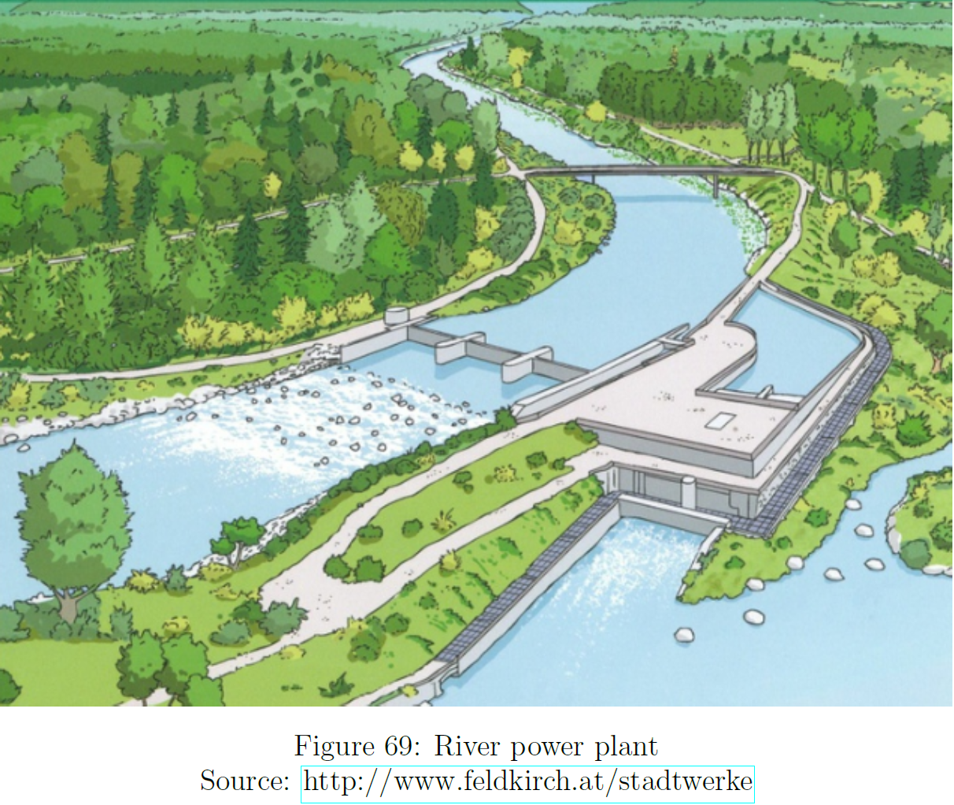
River Power Plant
Sediment transportation needs to be considered
River bends
Inside: silting of sand and gravel
Outside: rotating currents are removing sediments
Protect inlet channel from silting
power house at outside
Usually Kaplan turbines used
work very well up to 25 m fall height

Slide 8
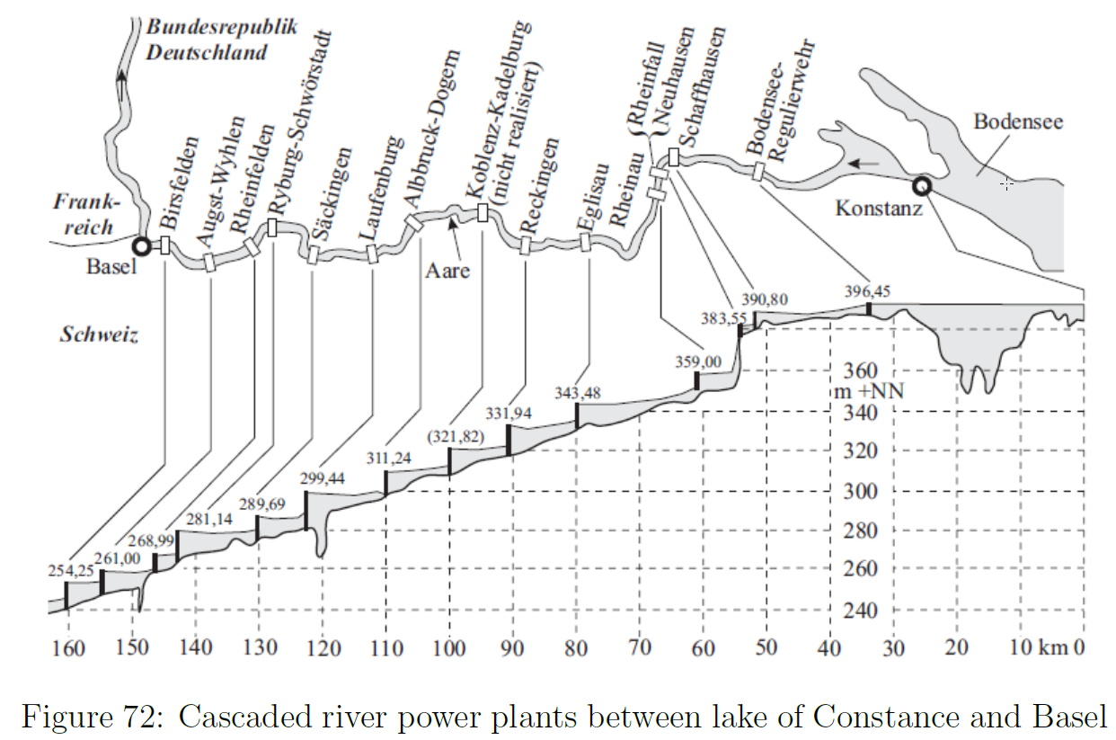
Cascaded river power plants
Suitable places
Large quantity of water
Good head over a large distance
Possible operation modes
Tipping operation (dt. Kippbetrieb)
Swell operation (dt Schwellbetrieb)

Slide 9
Cascaded river power plants
Tipping operation
All operating at the same time
Surface of water tips
Maximum output immediately available
Swell operation
Sequentially activating energy production
Water head swells from one plant to another
Water travels like a wave

Slide 10
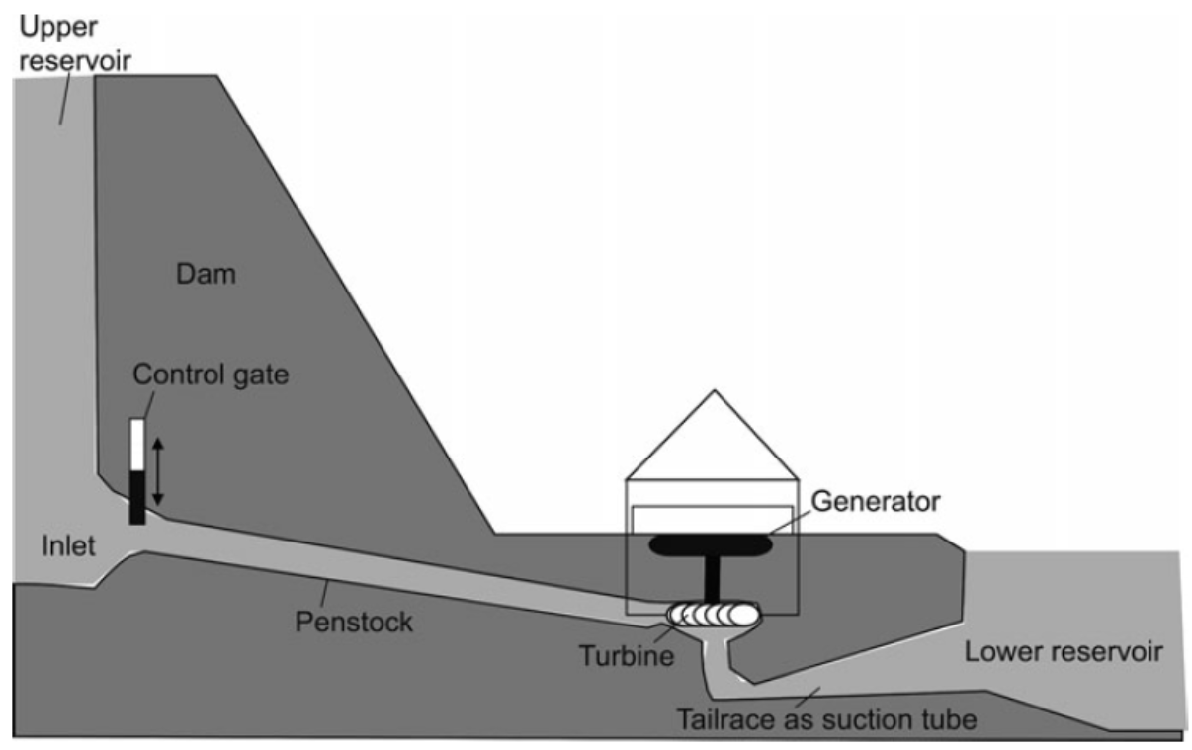
Storage Power Plants
Store potential energy until its usage is needed
E.g. for medium or peak load hours
May or may not have natural water influx
long distance pipes used in mountain areas to collect water
Used turbines
Usually Francis turbines used
up to 2000 m fall height
Hugh amount of water
Occasionally also Pelton turbines
15 to 500 m fall height
Work with smaller water flow

Slide 11
Pump Storage Power Plants
Located at high altitude
Have not enough water influx
Two water reservoirs are build
One on the bottom of the valley
One in the mountain
Water in these reservoirs are used to generate electricity
If water is quickly needed, water is send down through the turbine into the lower basin
Water in the lower basin is pumped up when cheap energy is available
Usually operating in a cyclic manner (dt. Wälzbetrieb)

Slide 12
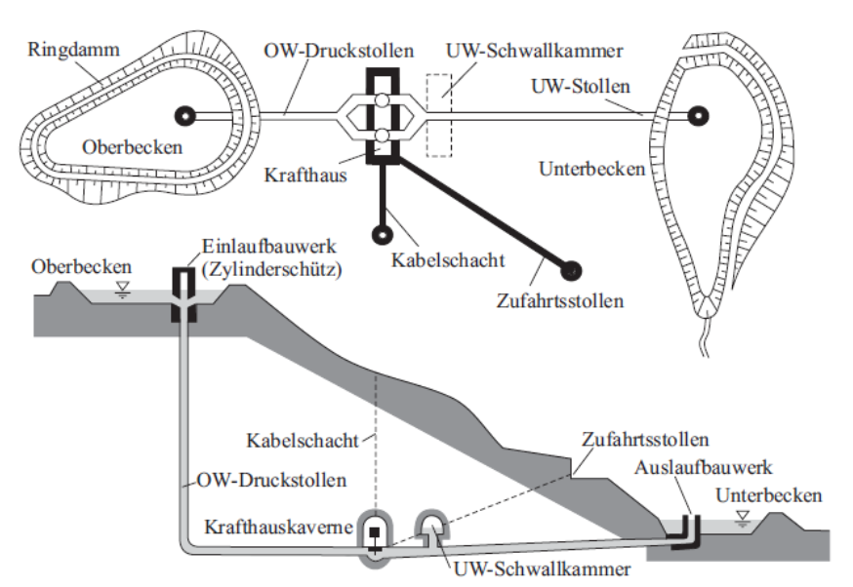
Pump Storage Power Plant

Slide 13
Pump Storage Power Plants - Objectives
Upgrading (dt. Veredelung) of base load energy to peak load energy
Use of excess power (dt. Überschussstrom). E.g. from thermal power plants
Cover for peak load
Supports optimization of thermal power operation (Maximize their efficiency)
Supports power frequency control (dt. Leistungsfrequenzregelung) by quickly providing real power
Supports voltage control by providing reactive power (Phase shifting operation)
Supports black start of collapsed grid parts

Slide 14
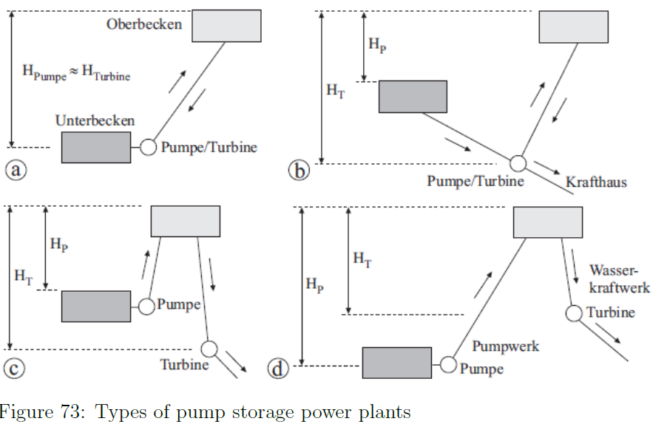
Pump Storage Plants
Classification
Pump storage power plant. Pump sees more than half of the water used by the turbine
Combined pump storage power plant. Natural influx is dominating

Slide 15
Pump Storage Plants
H_{T} = H_{P} ; Classical Pump Storage
Natural water supply from several reservoirs
E.g. water collected from 3 side valleys in Galtür-Wirl is pumped to Kops basin H_{P} = 130 m. Connected to Caverne power station in Partenen H_{T} = 800 m
In case of high water
water is pumped to higher altitude

Slide 16
Pump Storage
Modern storage pump have a pump head H_{P} of 500 to 800 m
Pump / turbine combinations
Francis turbines which can be used in both directions
They are reducing the construction costs by 30%
Pump and turbine separated -> Tandem sets (dt. Tandemsatz)
Pelton or Francis turbines

Slide 17
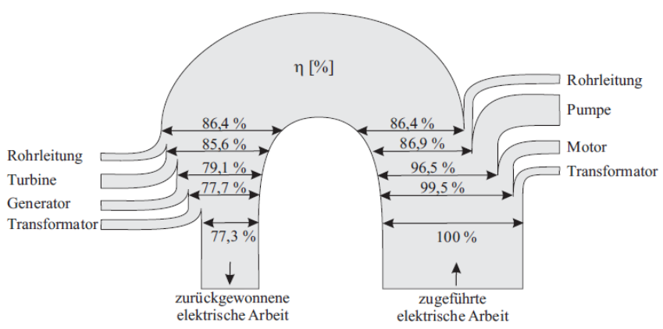
Pump Storage Efficiency
Efficiency – up to 80 %
Efficiency dramatically better than thermal power plants
Conventional coal power plants 40 to 45%
Nuclear power plants 30 to 34 %
Combined cycle gas turbines (CCGT) reaching 60%

Slide 18
Pump Storage Operation Modes
Cyclic Operation (dt. Wälzbetrieb)
Classical operation mode
Provide energy for peak load
Doing energy upgrading (dt. Veredelung)
Use base load energy to pump up the water
Usually the basins are big enough having water for 3 to 5 hours

Slide 19
Pump Storage Operation Modes
Liberalized electrical market – trade products
intraday trading
Increased share of fluctuating energy producers (WT, PV)
Price of peak load has decreased (Classical operation)
More thermal power plants are able to participate (spinning reserve)
Tertiary control (dt. Minutenreserven)
Low gas price – pump storage technology is competing with gas turbines
New measures needs to be established to ensure profitable operation
Capacity market ?

Slide 20
Pump Storage – Phase shifting operation
Pump storage can be used to provide reactive power (phase shifting)
Reactive power is required for magnetizing
Transformer
Induction machines (dt. Asynchronmaschinen)
Big synchronous machines are used
Manipulating excitation current
Thus changing the phase angle between voltage and current in the stator windings
During phase shifting
No mechanical power supplied or consumed via rotor

Slide 21
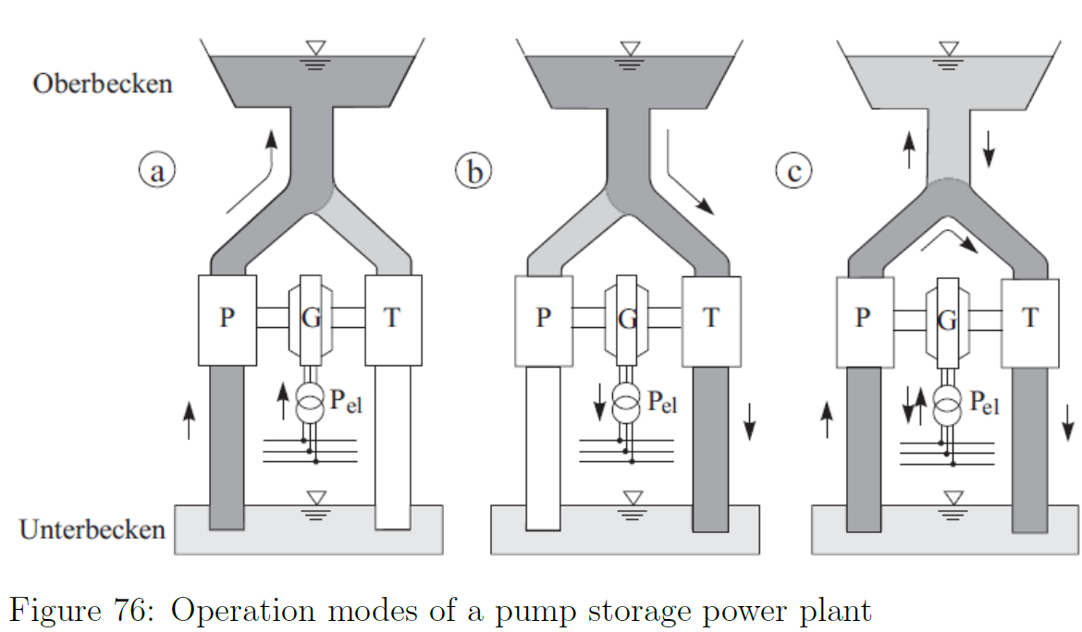
Pump Storage Power Plant
Pump mode
Generator mode
Hydraulic short circuit (dt. Hydraulischer Kurzschluss)
A fraction of the water flowing through the turbine during pumping

Slide 22
Pump Storage Power Plant
Requires
Regulating pump
Tandem set
Low losses in pipes and joints
Advantage
Entire output power of the plant can be used within seconds for
Primary control
Secondary control
Power frequency support

Slide 23
Pump Storage Power Plant
Turbine control is used to steer the level of the upper basin (const.; increase, decrease)
Kops II can perform such operation
3 machines
Each 150 MW

Slide 25
Oceanic Power Plants
Great variety of types
Wave power plants
Tidal Power plants (dt. Gezeitenkraftwerk)
Oceanic heat power plant
Current power plant
Besides tidal turbines, they are all in a stage of technical development

Slide 26
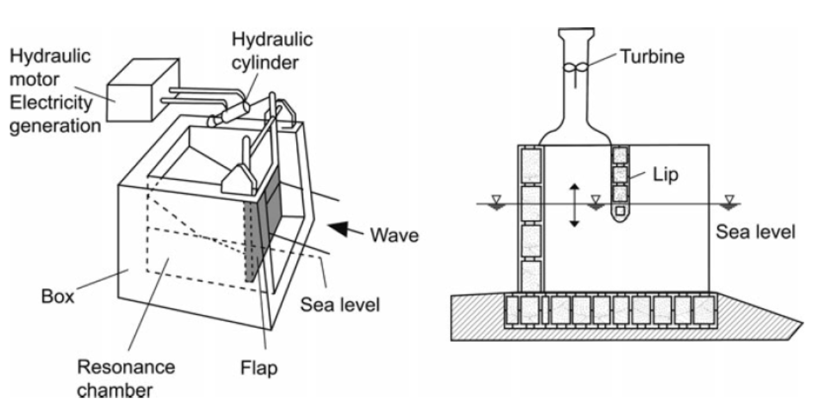
Wave Power Plant
Mechanically converts wave energy
Wave energy converted to pressure of fluid
Using a pendulum door (left scheme)
Wave water pressed air through a wind propeller (right scheme)

Slide 27
Tidal Power Plants
Similar constructed like river power plants
Have a dam
Water is stored on one side and during low tide on the other side

Slide 28
Oceanic heat power plants
Working principle Ocean Thermal Energy Conversion (OTEC)
Temperature differences between surface water and deep water
Difference is used to run a circuit which is used to produce electric energy
No OTEC power plant in commercial use

Slide 29
Current power plant
Works like under water wind energy plants
Energy of streaming water is converted by the rotor like a wind converter onshore

Slide 31
Fluid Mechanics
Water (H₂O) consists of one oxygen and two hydrogen atoms
Properties needs to be considered when constructing and operating a hydro power plant
Incompressible fluid
Increasing the pressure of water also increases the pressure to its surroundings
10 meters head is equal 1 bar
Water height of 800 m will result in 80 bar at the turbine

Slide 32
Fluid Mechanics
Density 1 gram per cm³
Increases volume between -4°C to -4°C
Could destroy machine parts
Heating required to avoid freezing
Evaporation
at 1 bar at 100°C
at 200 mbar already at 18°C
Solvent
Universal solvent, dissolves more substances then any other liquid
Results in leaches (dt. Laugen) or acids
Might cause damage by corrosion

Slide 33
Flowing velocity
High energy in flowing water
Sand starts moving at 0.3 m/s
Smaller gravel: 1 m/s onwards
Bigger gravel: 1.3 m/s
Past
River straighten to protect areas from flooding
Also increased flow velocity –> deepened the river bed
Lowering the groundwater level
Nowadays
Countermeasure – dam
Important argument for enabling hydro power plants

Slide 34

Flowing velocity
Basic working principle
potential energy due to its elevation h converted to kinetic energy
Amount of extracted energy
m: mass of water falling
v: velocity
g: accel. due to gravity
h: height
rho: density of water
V: Volume

Slide 35
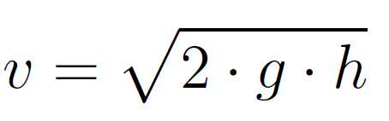
Flowing velocity
Previous equation can be re-written as
This equation shows that the velocity increases with the square root of the height.

Slide 36
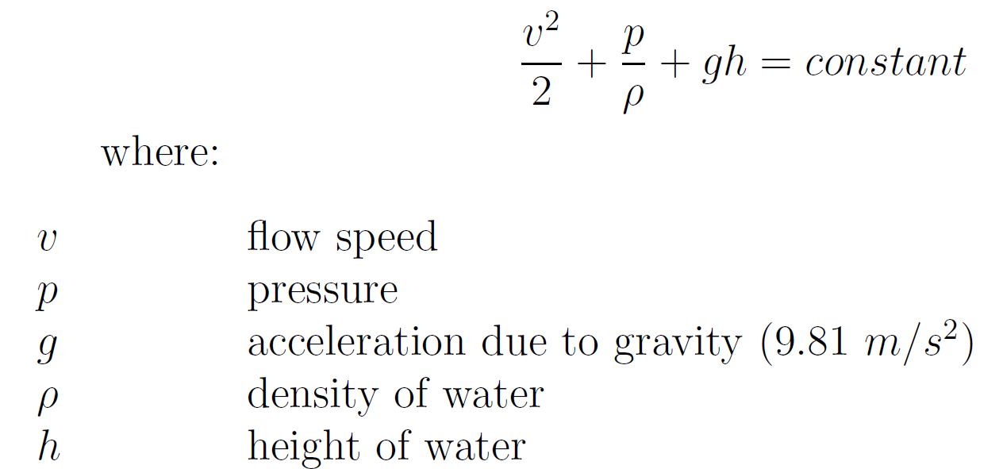
Extractable power
Bernoulli’s principle
Increase of velocity of a fluid causes
Decrease in pressure or a decrease in the fluids potential energy
Kinetic energy + pressure energy + potential energy = constant

Slide 37
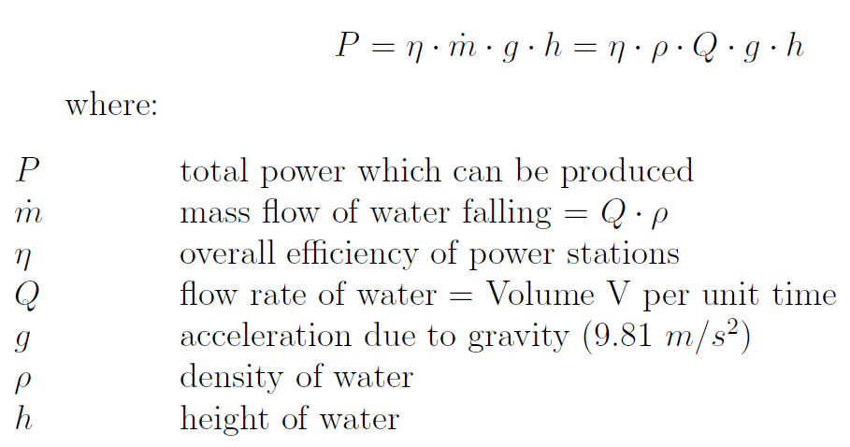
Extractable power
Water stored in an open reservoir at a height h has only one component for potential energy
Pressure and kinetic energy are absent
Thus, total power generated from water due its heights:

Slide 38
Extractable power
This equation shows, power output depends mainly on
Volume of flow
Height
Overall efficiency eta is dominated by the generator and turbine

Slide 39
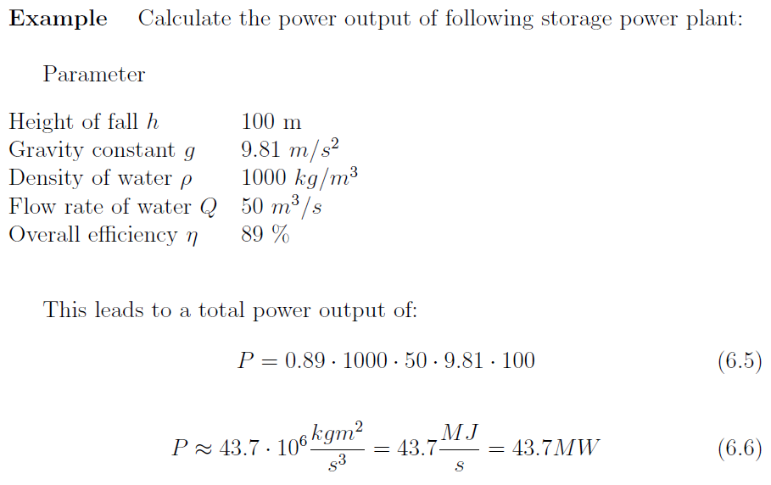
Calculation example

Slide 40

Continuity Equation
Continuity equation (dt. Kontinuitätsgleichung) states
Product of velocity v and cross section area A of flow remains constant
Incompressible is a property of water
For smaller cross section the water flow velocity increases
For larger cross section the water flow velocity decreases

Slide 41
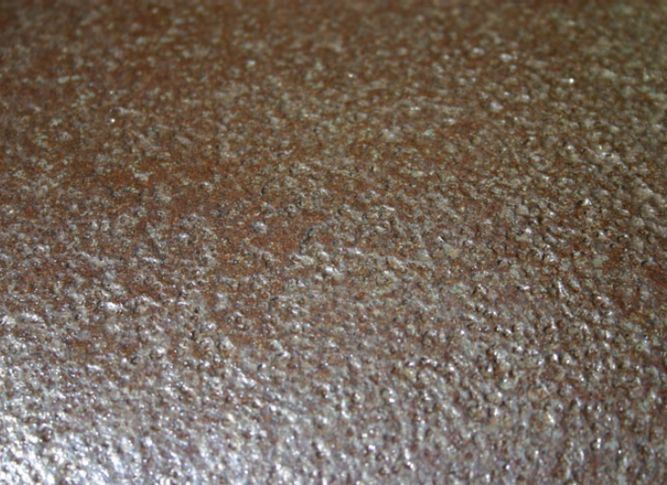
Cavitation erosion
Phenomenon cavitation erosion happens close to hydro power plant equipment
Water boils at low pressure.
Causes vapor bubbles
Water with bubbles travel toward low pressure zones
They collapse causing a rush of water fill the empty space and causing dents (dt. dellen) on the equipment

Slide 42
Cavitation erosion
Occurs under
high velocity
low pressure flow conditions
For instance a pump storage power plant
water is sucked in
pressure reduced to 20 mbar
water starts to evaporate at 18 °C
Pressure starts to rise at the pumping blades and pipes
Vapor condenses and becomes thiny drops
This drops have a very high velocity -> cause erosion

Slide 43
Cavitation erosion
Happens also when within pipes when the cross section A changes and thus also the pressure p
Computer Fluid Dynamics (CFD) software used for designing hydro power plants
In the daily operation cavitation cannot be avoided

Slide 45
Hydro turbines
Names after their inventors
Francis turbine
Pelton turbine
Kaplan turbine
https://www.youtube.com/watch?v=k0BLOKEZ3KU

Slide 46
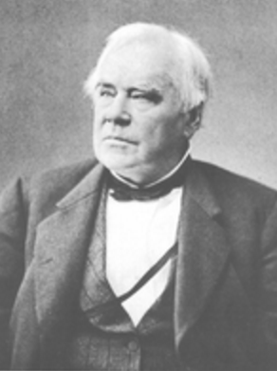
Francis turbine
James Francis
British-American civil engineer
Invented the Francis turbine 1849
Reaction machine
water flow changes its momentum
gives energy to the surface of the turbine blades
causes change of pressure due to their profile
https://www.youtube.com/watch?v=3BCiFeykRzo

Slide 47
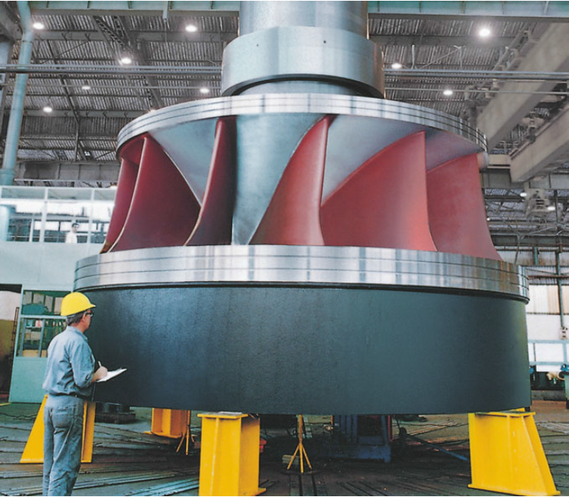
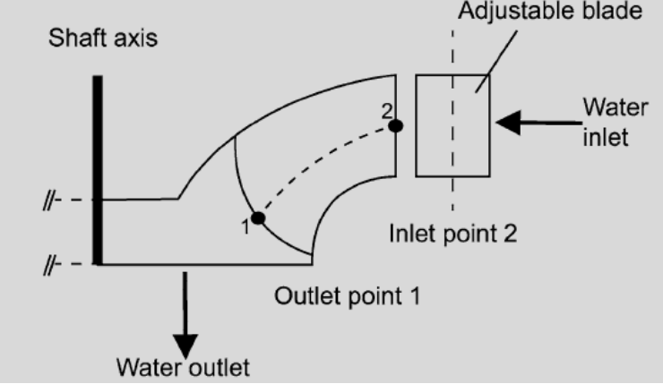
Francis turbine
Adjustable blades causing the water flow to enter at Inlet point 2
With an angular momentum in the direction of rotation
The curve shape of the rotor blades force the water to leave at Outlet point 1
The change of angular momentum of the fluid between runner inlet and outlet causes torque on the shaft
Guide vanes (in the stator) are directing the water tangentially to the turbine wheel
90° between inlet and outlet

Slide 48
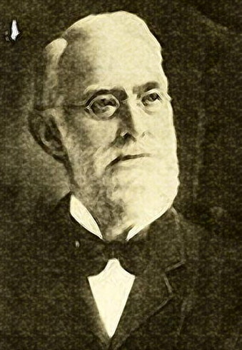
Pelton turbine
Lester Allan Pelton (1829 – 1908)
American inventor
Studied working principle during gold rush (mining)
Found out
Split double cup
Splitting the jet directly onto the common vane
stream kinetic energy is captured more efficiently
First turbine 1870
Impulse machine

Slide 49
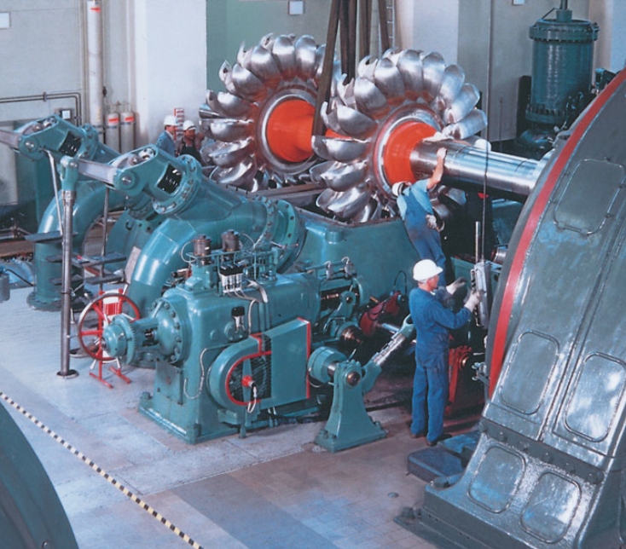
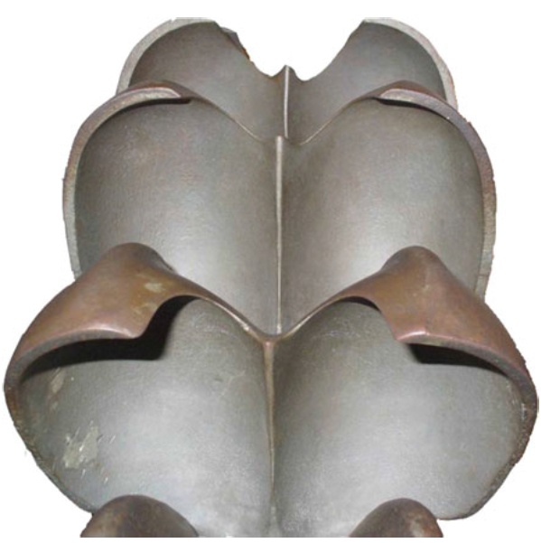
Pelton turbine
Circular disk mounted on the rotating shaft or rotor
Disk carries cup shaped blades (called buckets)
Single or multiple nozzles are arranged around the wheel
High speed jets striking the buckets at the splitter in the middle of the bucket
Stream divided into two equal streams
These streams flow along the inner curve
Leave it in a almost opposite directions

Slide 50
Pelton turbine
The change in momentum due to the loss in velocity and change in direction of the water stream produces an impulse
This impulse generates the torque and causes the shaft rotation
Power generator directly coupled on the same shaft
constant frequency required
Servo controlled spear valves (Speer Ventile) are used to adapt the flow rate
Water is nearly incompressible
most of available energy is extracted at the first stage
Therefor Pelton turbines have only one stage (Unlike gas turbines)

Slide 51
Kaplan turbine
https://www.youtube.com/watch?v=0p03UTgpnDU

Slide 52
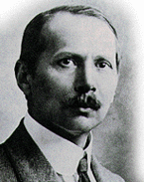
Kaplan Turbine
Victor Kaplan
Born 1876 in Mürzzuschlag, Austria
Civil Engineer (dt. Maschinenbau-Ingeneur)
Professorship at the institute of civil engineering in Brno
1912 he published his most notable work: the Kaplan turbine

Slide 53
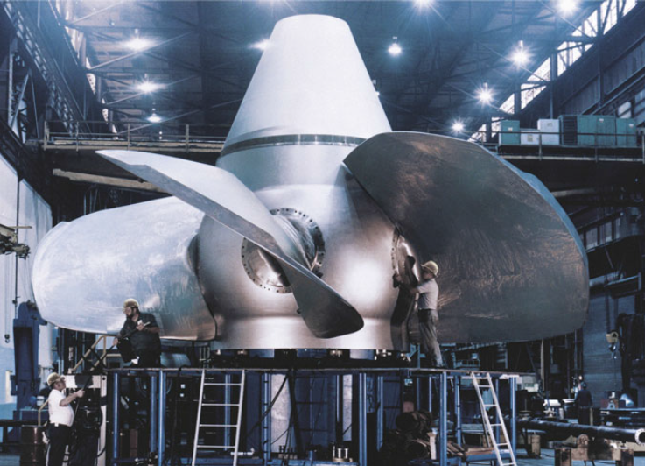
Kaplan turbine
Rotor looks like a propeller of a ship
Movable rotor blades
Specially suitable for low heights
Reaction turbine
Can be used horizontally or vertically

Slide 54
Propeller turbine
Same as Kaplan turbine, but with fixed blades

Slide 55
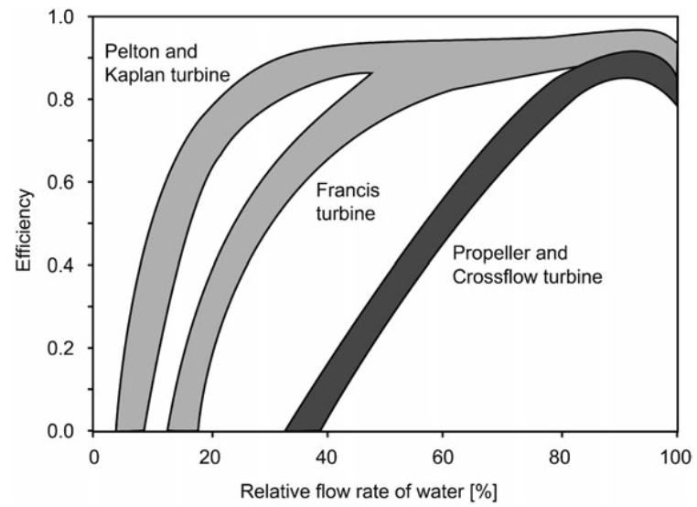
Efficiency
Depends on water flow and turbine type
Kaplan and Pelton have high efficiency over a wide range of water flow
Propeller turbines are presenting a distinct optimum

Slide 57
Biofuels
Derived from vegetable matter
agriculture
waste materials
Burning
wood, dung, ...
Produce electricity in two ways
Burning in a furnace to produce steam
used as fuel for ignite engine or gas turbine
co-fired with coal in large steam power plants

Slide 58
Solar Energy
Photovoltaic conversion
thin layer of suitable material (typical silicon)
Discontinuity in electrochemical potential creates a potential differences
Theoretical efficiency is about 25%
Occupy large areas in order to produce MW outputs

Slide 60
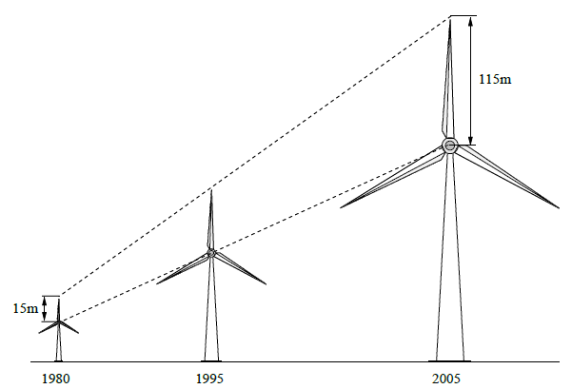
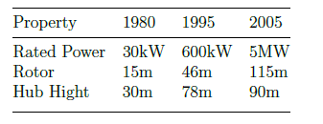
Wind Power Plants
In recent years the output power increased
Increasing the rotor size
1980 – 15 meter
2005 – 115 meter
Getting taller
Most of the components in the nacelle
Drive train
Gear box
Generator

Slide 61
Wind Turbine
As the output power increases also the grid connection requirements are increasing
They have to stay connected even during a grid fault
They have to support the grid
In early days the simply switched off
E.g. they have to stay connected during low voltage conditions for up to 150 ms

Slide 62
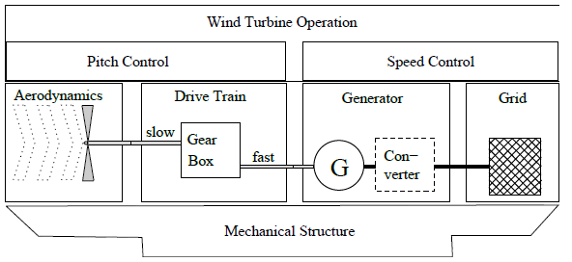
Energy conversion
Energy conversion systems
Converting kinetic energy from moving air into mechanical rotation
Most used type
Three blades
Horizontal axis (HAWT)
Wind drives the blades
Connected via hub to the slow moving shaft
Over the gear box connected to the fast moving shaft
Drives the rotor of the generator
Connected to the grid

Slide 63
Mechanical system / Electrical system
Mechanical system and electrical system are influencing each other
Wind is fluctuating, therefore changing conditions are applied to the mechanical structure

Slide 64
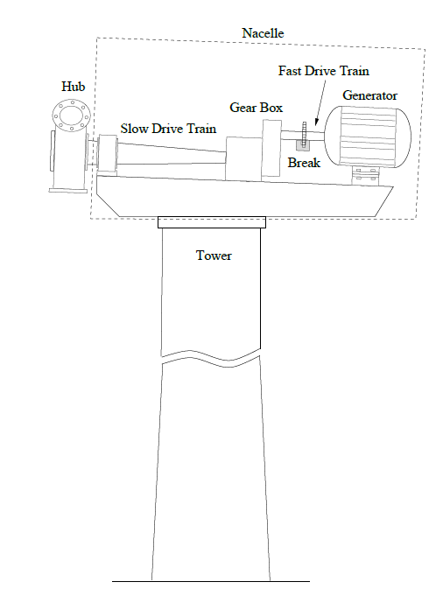
Important components
Rotor blades, aerodynamical brake and hub
Drive train, bearings, break, gearbox, generator
Yaw drive to move the nacelle into the wind
Tower and foundation
Electrical components for control and grid connection

Slide 65
Aerodynamics
Most WT have two or three bladed horizontal axis
Two blades
Easier to assemble
Have to spin faster
Higher noise emission
More mechanical stress (tower shadow)
Rotor is mounted on top
Wind speeds are higher
Thus more energy can be extracted

Slide 66

Aerodynamics
Air velocity V moving through the area A is proportional the air density rho and the third power of the velocity V

Slide 67
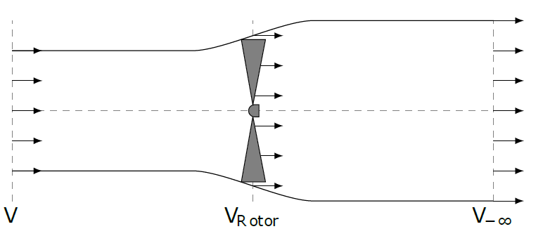
Aerodynamics
Only a part of the energy can be extracted
Described in the model of Albert Betz
undisturbed air stream in V in front
after passing the downstream velocity is V_{-Infinity}

Slide 68
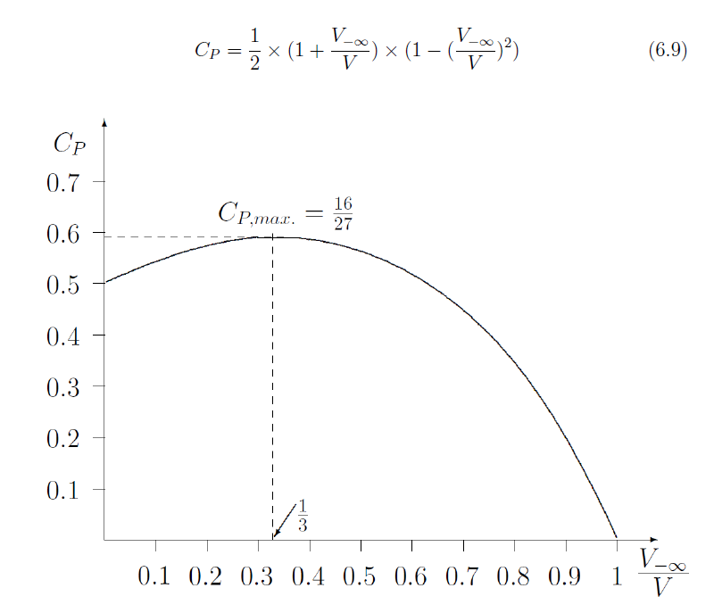
Betz model
Based on the described Betz model
Power extracted from the moving wind is the power within the wind multiplied by the so called Betz coefficient
Power coefficient C_{P} cannot be higher than 16/27
Modern WT get as close as 70 to 80% of the calculated maximum Betz coefficient

Slide 69
Working principles
Aerodynamic profile
Pressure difference caused by moving the air with different velocities along the surface of the blades
Creates a lifting force
This force accelerated the blades up to a speed three to four times faster than the wind speed
Having the blades connected via hub to the drive train converts the lifting forces to a torque at the drive train.

Slide 70

Force calculations
Two major approaches
Actuator disc theory
Blade element method (BEM)
Actuator Disc Theory
Area swept by the blades are seen as disk
Air flow through disk causes an air velocity decrease
Thus the force at the disc is the velocity drop multiplied by the mass flow rate

Slide 71
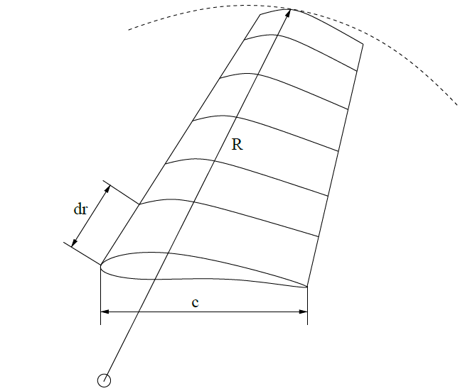
Force calculations
Blade element method (BEM)
Widely used by wind turbine control design
Based on applying aerodynamic forces on axial blade elements
Blade is divided into N number of elements (between 10 – 20)
Forces applied to each element is determined by the lift and drag coefficients
Each single element experiences a different air flow
different speed rotation Ωr
different blade profile (cord length c, twist angle gamma)

Slide 72
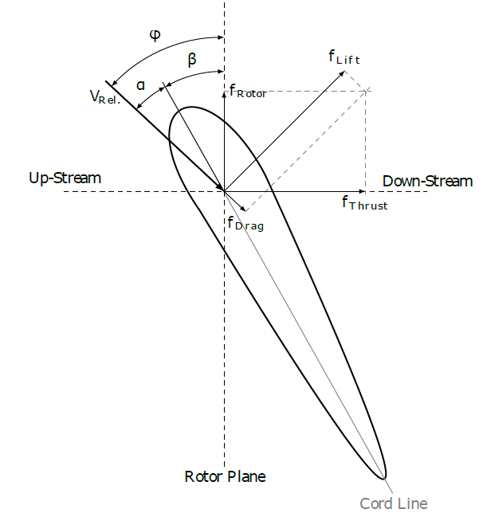
Blade element
Upstream point of view
blades are turning clockwise
Airplane wing like shapes – turning faster then the wind blows
Because air stream velocities moving along the blades surface causing under pressure and thus forces
f_{Lift} causes the blade to move
f_{Lift} is perpendicular to relative air stream V_{Rel}
f_{Drag} is parallel to the relative air stream
Sum of f_{Lift} and f_{Drag} can be divided into
Rotor plane direction f_{Rotor}
Axial direction f_{Thrust}

Slide 73
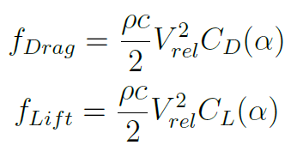
Aerofoil
Forces f_{Lift} and f_{Drag} are depending on
The air stream velocity V_{rel}
Blade shape
Angle alpha of the airfoil in the air stream.

Slide 74
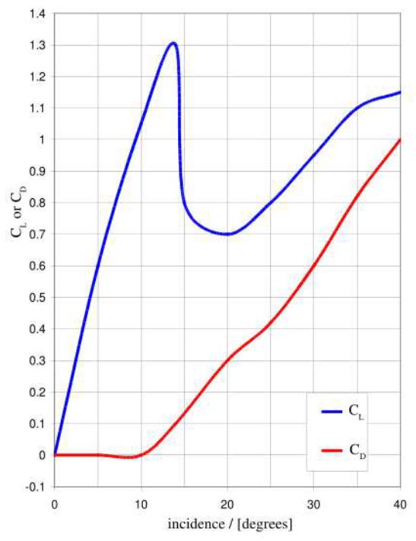
Typical airfoil NACA 0012
Lift and drag coefficients of a typical aerofoil
Designed in such a way that between 0 – 10°
C_{Lift} = linear
C_{Drag} = close to zero

Slide 75
Mechanical Structure
Lattice tower
Tubular steel tower
Oscillating forces are acting
Aerodynamic excitations; e.g. tower shadow
Hydrodynamic excitations; waves at offshore wind turbines
Operational excitations; caused by pitch or generator controller
Unbalanced loads; e.g. damaged blade caused by lightning, ice

Slide 76
Generator
Directly coupled induction generator systems
Doubly fed induction generator systems
Synchronous generator systems
In the past
Generators directly connected to the grid frequencies
Called fixed-speed wind turbines
Reliable, low cost
Do not adapt to wind variations

Slide 77
Generators
Variable speed wind turbines
not directly coupling their rotational frequency to the grid frequency
Operate the wind turbine always at the most efficient speed
Decoupling via
Gear box
Converters
Used generators
Induction
Synchronous

Slide 78
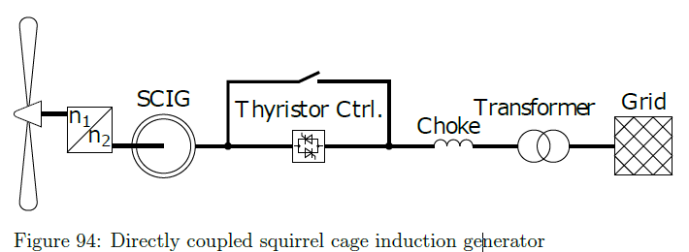
Directly coupled induction generator
Induction generator tied to the grid
Gearbox needed
Constant speed concept

Slide 79
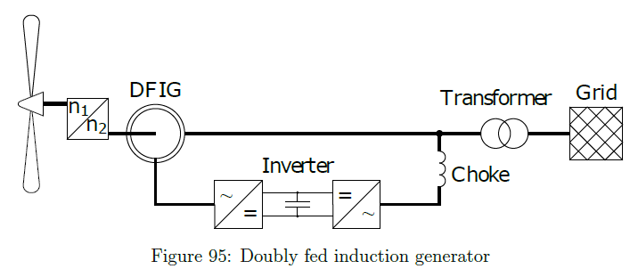
Doubly fed induction generator (DFIG)
Changeable generator input speeds
Stator directly connected to the grid
Rotor field manipulated by an back-to-back converter
Speed can change between +/- 40 % of the synchronous speed

Slide 80
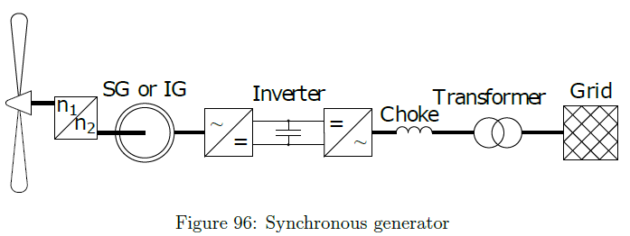
Synchronous generator
Full variable speed concept
Decoupling the generator totally from the grid by using a back-to-back inverter
Permanent magnet synchronous generator mostly used
No gear box needed

Slide 81
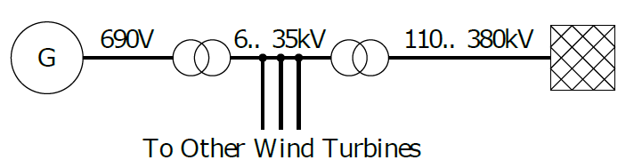
Grid connections
Generator voltage 690 V L-L RMS
Connected to the grid via point of common coupling (PCC)
Depending of the output power
Medium voltage
High voltage connection

Slide 82
Grid codes
Connection restrictions defined in the Grid Codes
Frequency control; Fast output power control
Voltage control; Reactive power control
Black start capabilties

Slide 83
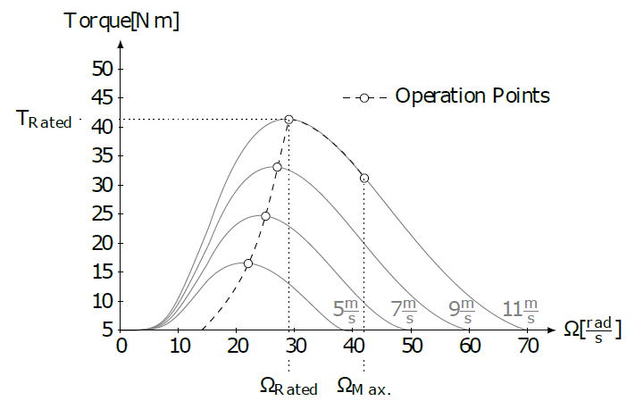
Control
Target
Maximum energy can be extracted
Keep rotational speed for each wind speed at is optimum
If the wind gets too strong, two methods to limit power capture
Pitch control; move blades
Stall control; blade design

